Slide 1
Introduction to Python Programming
Girish S Kumar

Slide 2
What is Python
Python is an easy to learn, powerful programming language
This is an ideal language for scripting and rapid application development in many areas, like business apps, Web Applications, Back end Server side apps, IoT and embedded system

Slide 3

Python was developed by a Dutch Computer Programmer Guido van Rossum as a Computer Programming for Everybody
Originally developed as a hobby project during his holidays during 1989, he came out with a set of goals for his language by 1999 which was :
An easy and intuitive language just as powerful as major competitors
Open source, so anyone can contribute to its development code that is as understandable as plain English
Suitability for everyday tasks, allowing for quick development of apps
Guido van Rossum

Slide 4
Features of Python
Python is a simple and minimalistic language. English pseudo-code nature of Python is one of its greatest strengths
Easy to Learn
Free and Open Sourced
High level Programming : in Python, you never need to think about the low-level details such as managing the memory used by your program, etc
Interpreted, this mean the python program is not converted into machine language binaries file before it is executed. Instead a program called interpreter read each line converts into byte code and executes it directly. This make python programs portable across many hardware platforms
Its features can be extend If you need a critical piece of code to run very fast or want to have some piece of algorithm not to be open, you can code that part of your program in C or C\++ and then use it from your Python program.

Slide 5
Python has a large Standard Library. It helps programmers to do many complex operation which includes regular expressions, documentation generation, unit testing, threading, databases, web browsers, CGI, FTP, email, XML, XML-RPC, HTML, WAV files, cryptography, GUI (graphical user interfaces), and other system-dependent stuff. Without writing the fresh code. Standard library appears to programmer a like “Box full of components” that can be assembled to build something complex.
Python comes with powerful inbuild features like text processing which is not available on other programming languages like C/C++. To aviail these benefits we can call python modules from a C/C++ program. This make Python embeddable in other languages

Slide 6
Installing Python on your machine
https://www.python.org/downloads/

Slide 7
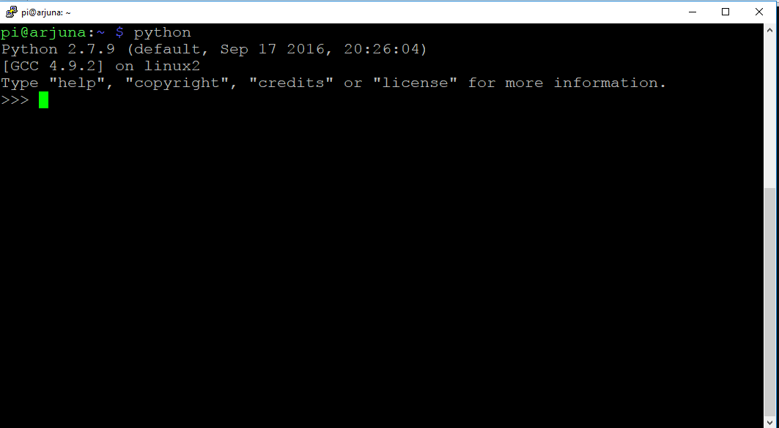
Invoking Python interpreter

Slide 8
Running python instruction
pi@arjuna:~ $ python
Python 2.7.9 (default, Sep 17 2016, 20:26:04)
[GCC 4.9.2] on linux2
Type "help", "copyright", "credits" or "license" for more information.
>>> x = 10
>>> y = 20
>>> x + y
30
>>> z = x+ y
>>> print z
30
>>>
>>> exit(0)
pi@arjuna:~ $
Starting Python
Creating two variable x and y
X + y is printed

Slide 9
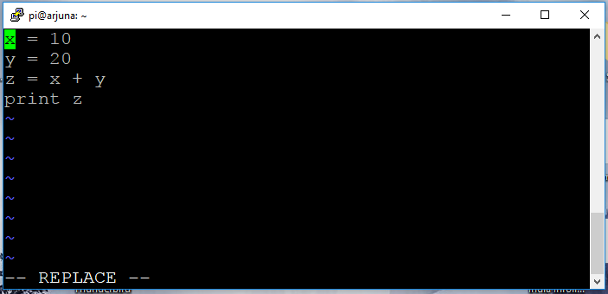
Running python from a file
pi@arjuna:~ $ vim.tiny first.py ; Open a file first.py – File must have .py extenstion
pi@arjuna:~ $ python first.py ; ; type python on the command line and mention the filename as argument

Slide 10
